Slide 1
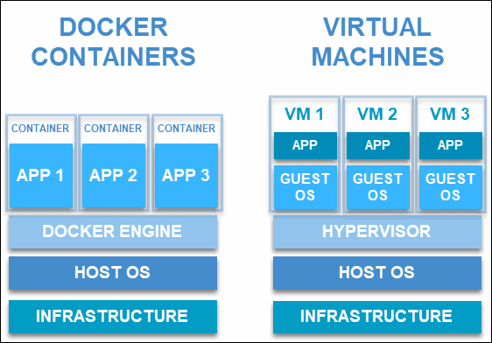
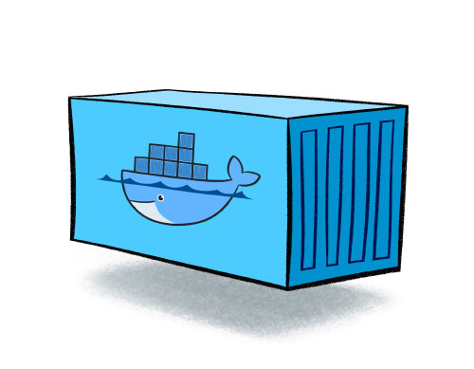
Container > Building block

Slide 2
Container > modular application
- containers are application packaging and delivery technology
- Stripped Down Linux OS version as image technology
- Remote control the container with shell/commandline
- Reconfigurable and Build from existing docker image
- Multiple containers communication
Need to understand Linux file System
Where and how to put your application on a container ?
How to run your application in the container?
Docker Desktop
dockerfile

Slide 3
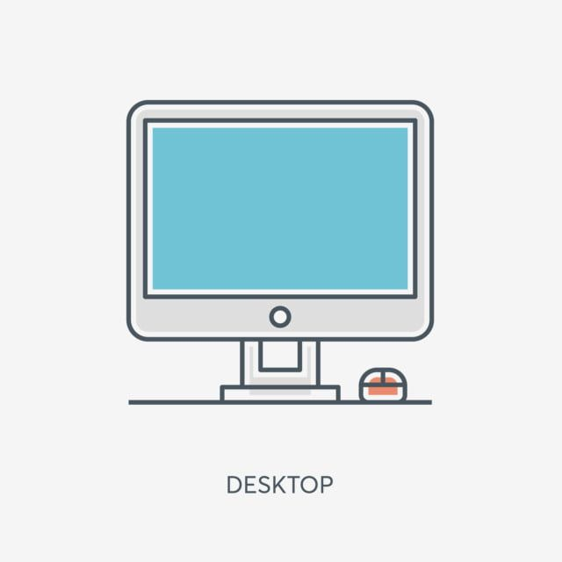
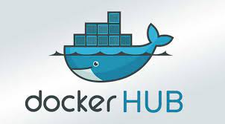
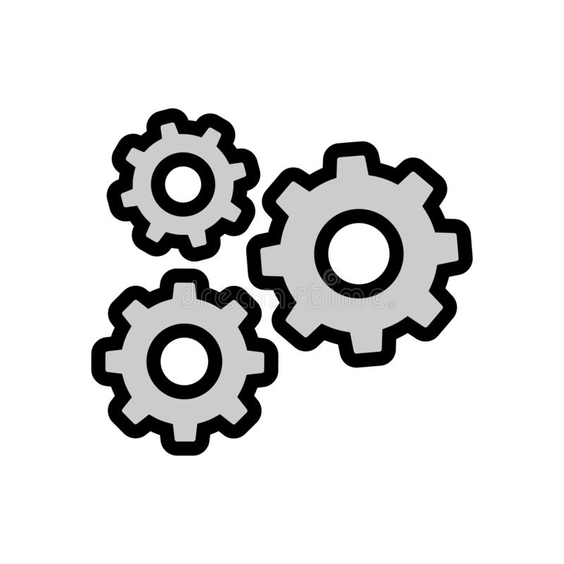
Container> build docker image
python script1.py
C:\stack1\script1.py
C:\stack1\
/usr
/app
/script1.py
docker script: c:\stack1\dockerfile
//1.Download a linux with python image from docker hub
/home
//2. Tell which container target directory to work with
//3. Copy your application file from a local directory to the docker
//4. Define how to run your application

Slide 4
Container> Docker Image building Commands
no | Command | Parameter | parameter
Select image from repository | FROM | Image name
Set working directory On the docker image | WORKDIR | Target directory
Copy file from src to destination | COPY | Source directory | Destination directory
Execute command | RUN | command
Commandline parameter | ENV
Export port | EXPOSE
Exeucte a single foreground command | ENTRYPOINT | ["command","parameter"]

Slide 5
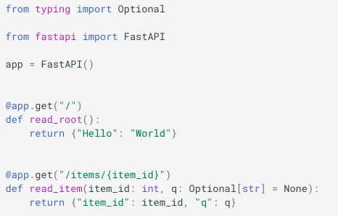

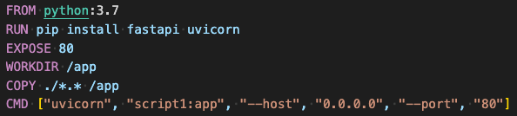
Container> Lab1. A fast api python service application
1. Create a new folder
local machine
Image/remote
C:\stack1\
/usr
2. Create a python webservice script with:
# use type and optional
app\
/script1.py
script1.py
/app
# use FastAPI Class
Dockerfile
/home
# create a new application object
4. On your terminal/command line, issue the following command
#annotate httpGet with root path
docker build -t image1 .
#define a service action
#annotate httpGet with items path
5. On your terminal/command line, issue the following command
3. Create a Dockerfile with:
docker run -d --name container1 -p 80:80 image1
//download an image with python support
//install fastapi and uvicorn libs
//allow outside world to connect with the container on port 80
//set working directory as /app on the container
//copy all of the file from c:\stack1\*.* to container directory /app
http://localhost:80
Script1: 80
//tell how to run your python app

Slide 6
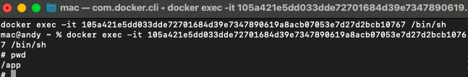
Container> Container remote control
Open in browser
start/stop
reload
remove

Slide 7
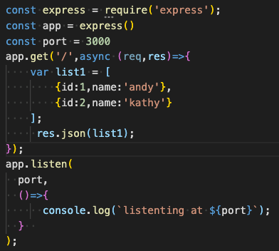
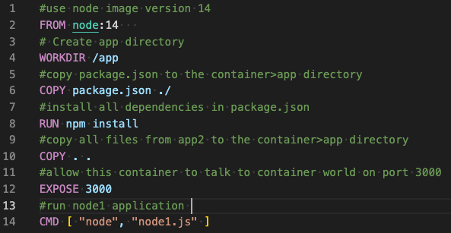
Container> Lab2. A node JS Web service application
1. Create a new folder
2. Create a nodeJs web service script
3. Create a Dockerfile with:
C:\stack1\
app2\
//use express
Node1.js
//create web service object
dockerfile
//an action to service data
//return json of list1
//start app service here
4. On your terminal/command line, issue the following command
docker build -t image2 .
5. On your terminal/command line, issue the following command
http://localhost:3333
Script1: 3000
docker run -d --rm --name container2 -p 3333:3000 image2

Slide 8

Container> http certificate
dotnet dev-certs https -ep ${HOME}/.aspnet/https/core5-website.pfx -p 12345678
dotnet dev-certs https --trust
dotnet dev-certs https --check --verbose
Ref:
https://docs.microsoft.com/en-us/aspnet/core/security/docker-compose-https?view=aspnetcore-5.0

Slide 9
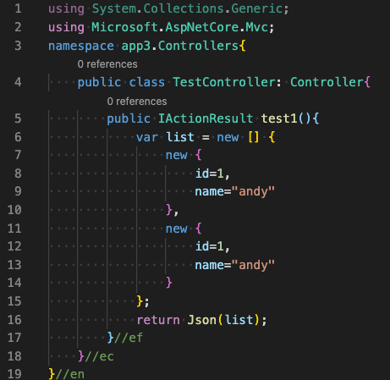
Container> Lab3> Multiple container creations> Test Controller

Slide 10
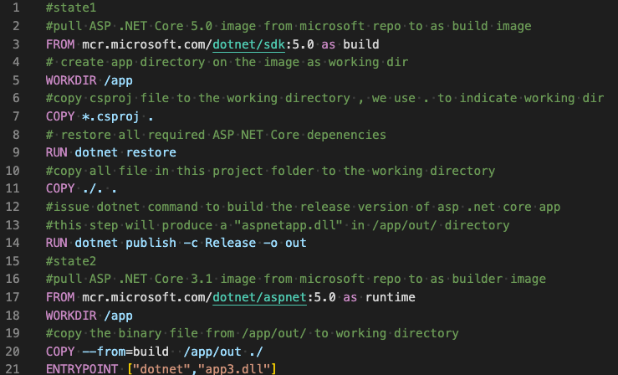
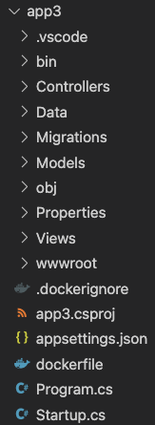
Container> Lab3> Multiple container creations> dockerfile
Image/remote
/usr
/app
/ app3.csproj
…….
/home

Slide 11



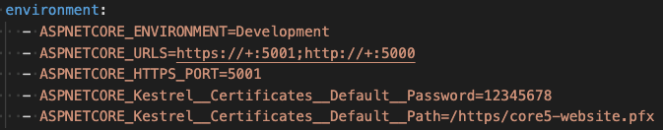

Container> lab3> docker-compose.yml

Slide 12
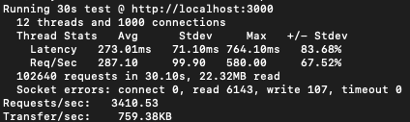
Container> load test application service
wrk -t12 -c400 -d30s http://127.0.0.1:8080/index.html
-t12 //12 threads
-c400 //open 400 HTTP connections
-d30s //run for 30 seconds
https://github.com/wg/wrk

Slide 13
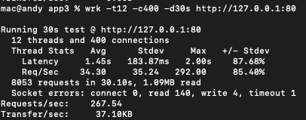
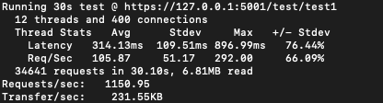
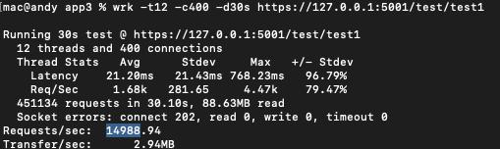
FastApi container
ASP .Net Core container
ASP .Net Core on local computer

Slide 14
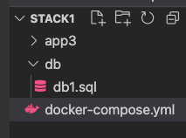
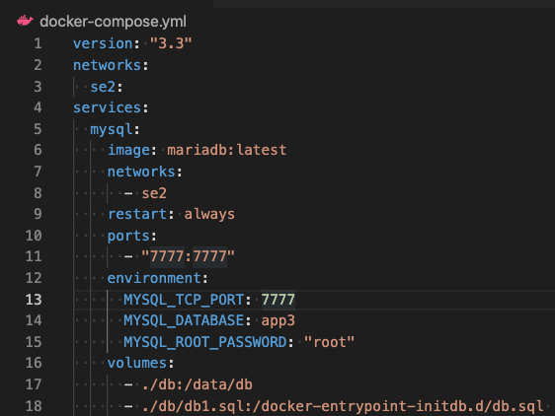
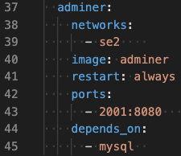
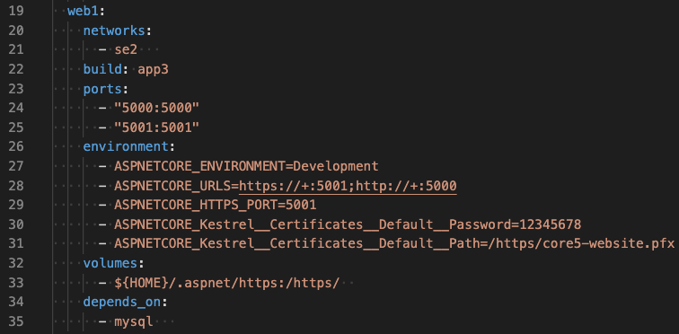
Container> load test application service

Slide 15
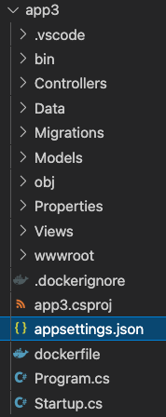
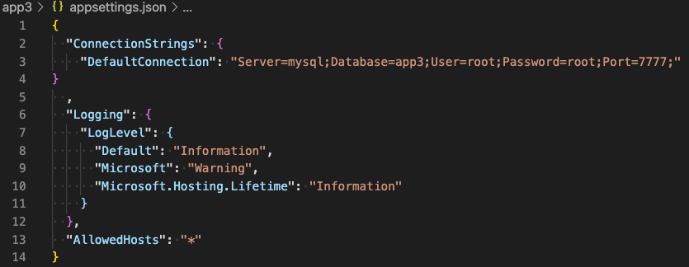
Container> load test application service

Slide 16
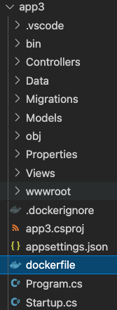
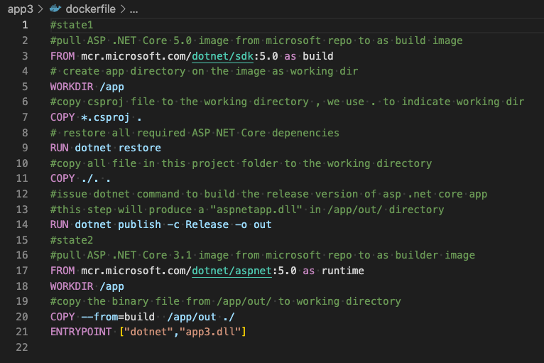
Container> load test application service

Slide 17
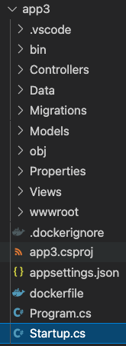
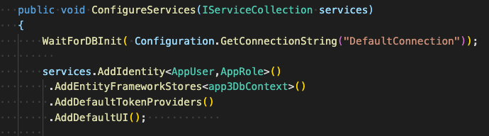
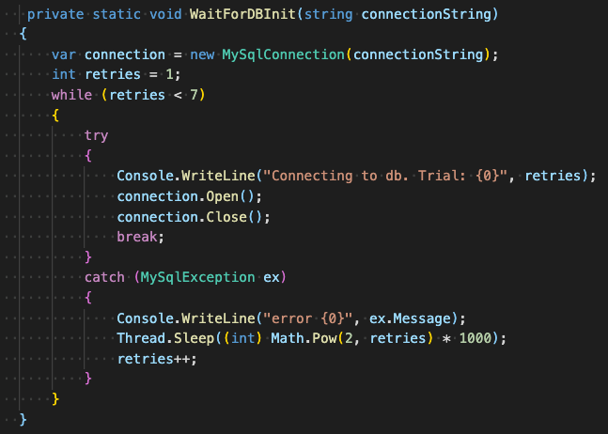
Container> load test application service

Slide 18
Container> stack architecture
se2
mysql
web1
adminer1
mariadb
Dotnet core
adminer
7777
5000
5001
8080
7777
5000
5001
2001
Local computer

Slide 19
Container> stack architecture
se2
mydrive
ds
Python + data science libs
proxy
pp
ubuntu
nginx
portainer
8050
80
9000
mysql
web1
adminer1
mariadb
Dotnet core
adminer
7777
5000
5001
8080
8050
80
7777
5000
5001
2001
1003
mydrive
Local computer

